Slide 1
Pricing of Internet Access
Nick Feamster

Slide 2
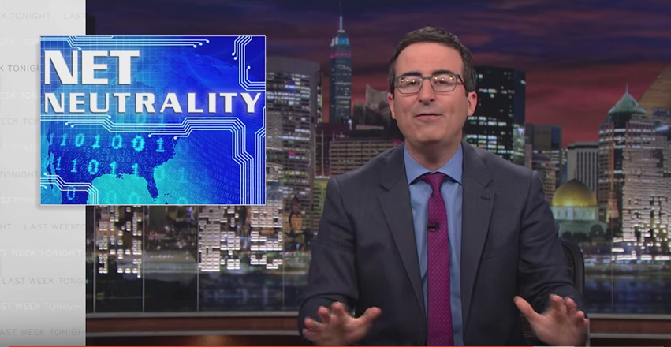
Internet Congestion and Network Neutrality

Slide 3
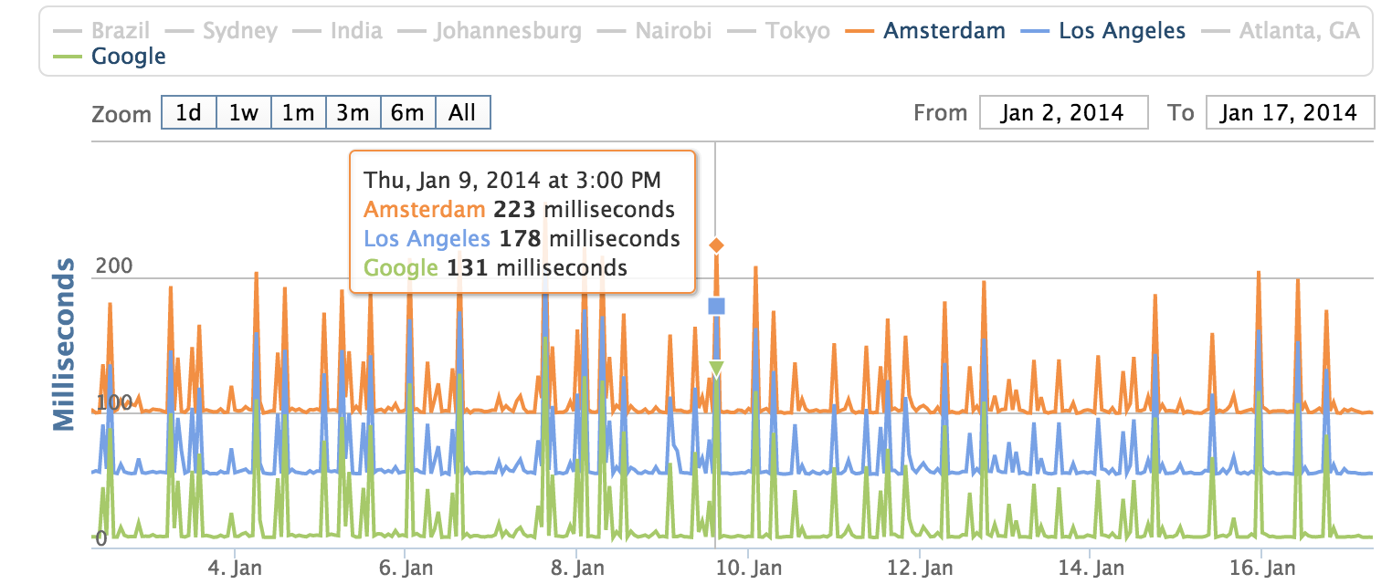
Internet Congestion at Home

Slide 4
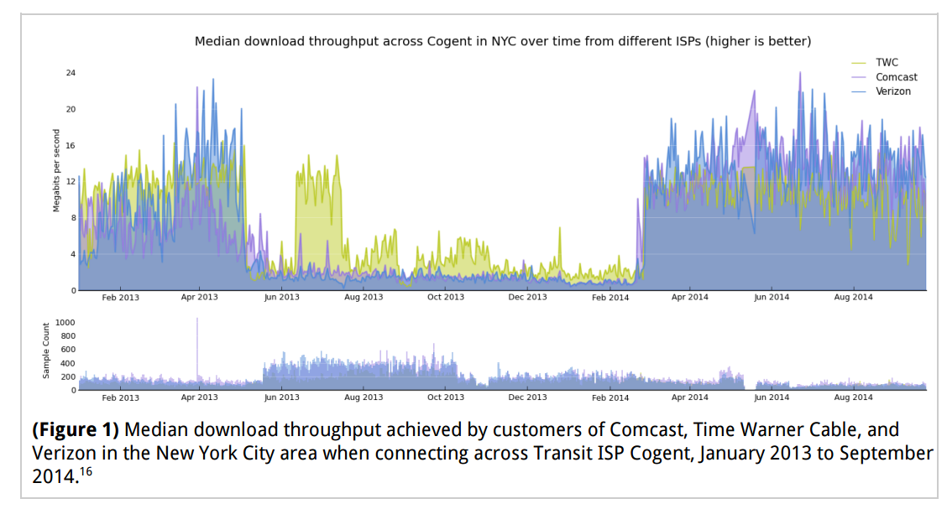
Another View: Across a Transit Provider

Slide 5
So… Was Comcast “Blocking” Netflix?

Slide 6
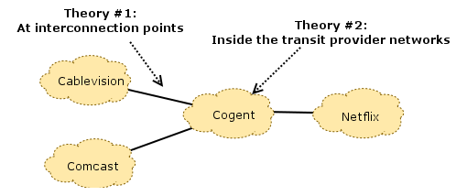
What’s Causing This?

Slide 7
Two Sides…
Netflix asserts that, by paying their transit providers, they have already paid for access to Comcast’s consumers (the “eyeballs”), and that it is the responsibility of Comcast and their transit providers to ensure that these links are provisioned well enough to avoid congestion. The filings assert that Comcast “let the links congest” (effectively, by not paying for upgrades to these links).
Comcast, on the other hand, asserts that Netflix has enough traffic to congest any link they please, at any time, as well as the flexibility to choose which transit provider they use to reach Comcast.

Slide 8
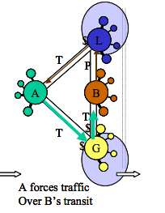
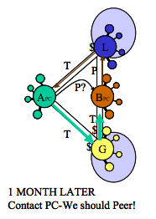
The Peering Playbook
“One of the more devious of all the tactics presented is the Traffic Manipulation Tactic. To understand this tactic you must recognize that the nature of web traffic is asymmetric, that is, small requests result in large responses. The Content hosters therefore decide which of potentially many paths this relatively large proportion of traffic will flow.

Slide 9
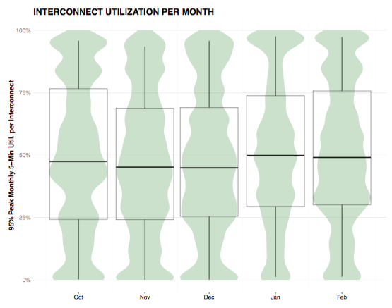
Where the Congestion Occurs Depends on the Link

Slide 10
The Open Internet Order (March 2015)
Reclassification of ISPs as “title 2” common carrier (forbearing many of the common clauses for title 2 providers). (Like a public utility.)
Upshot: ISPs prevented from discriminating.
Interestingly, content distribution networks were exempted from the process.
Perhaps we are barking up the wrong tree…

Slide 11
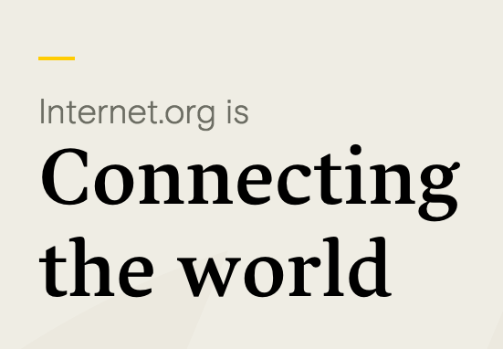
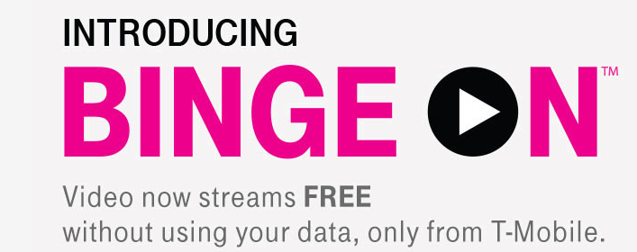
Zero-Rating and Bundling

Slide 12
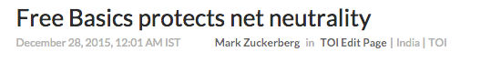
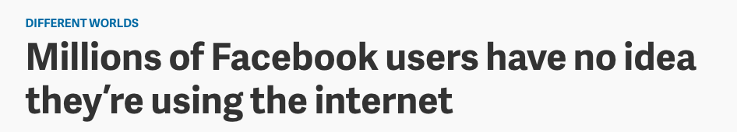
Network Neutrality Comes Home to Roost

Slide 13
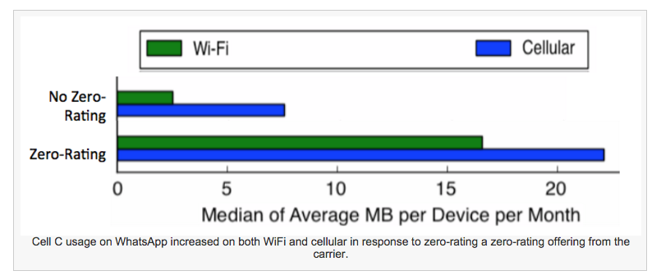
Zero-Rating Affects Usage…

Slide 14


Exploring the Walled Garden Theory
An Empirical Framework to Assess Pricing Effects on Mobile Data Usage
Ava Chen Princeton University avac@alumni.princeton.edu | Nick Feamster Princeton University feamster@cs.princeton.edu | Enrico Calandro Research ICT Africa ecalandro@researchictafrica.net
Notes:
An empirical study on the effects of pricing on mobile data usage
An empirical study analyzing pricing effects on mobile data usage

Slide 15
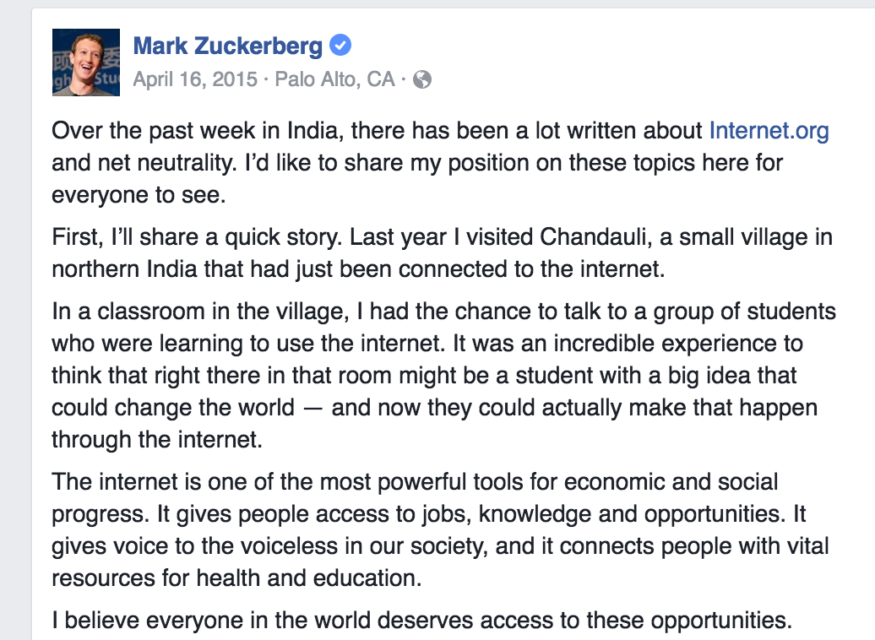
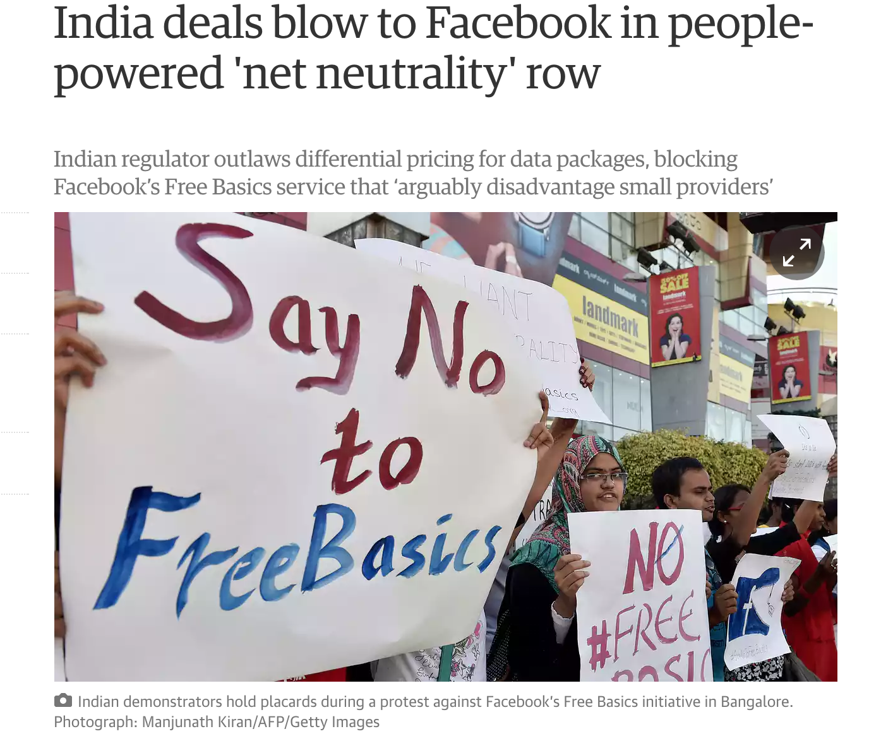

Slide 16
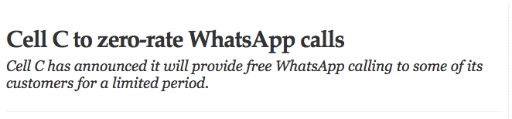
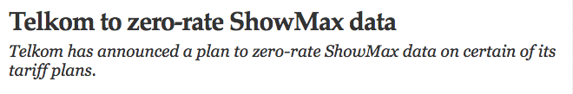
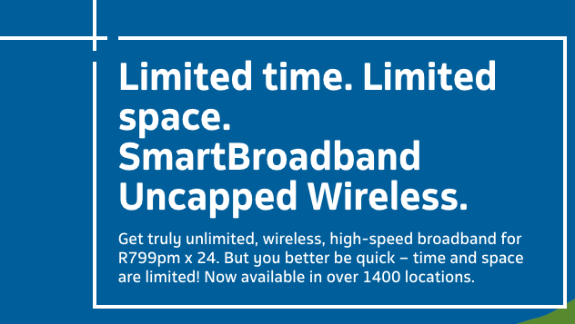
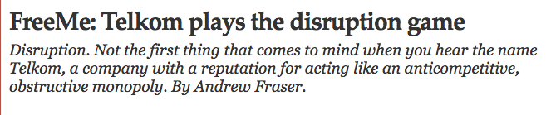
Goal: Study the Effects of Pricing on Mobile Data Usage

Slide 17
Measurements and Approach
Longitudinal analysis of mobile usage patterns
MySpeedTest Android application
Measures application usage in 15-minute intervals, by traffic volume (in bytes)
Qualitative analysis of zero-rating effects
Mobile-based survey
User survey to give more insight into observed measurments
Notes:
Key insight: analyze longitudinal data on a diverse range of global users to explore possible pricing effects on long-term mobile data usage patterns, in addition to collecting survey responses for a more focused comparative analysis on the impact of zero-rating in developing countries. An empirical analysis on this subject actually hasn’t been studied at great length before.
Another unique aspect of this research is that it makes use of new data that has never been analyzed for this purpose. Our two sources of data come from the MySpeedTest application and a survey instrument that we created and distributed to users in South Africa and Kenya.
MySpeedTest is a mobile application created in-house that collects data on a device’s network performance (e.g. throughput and latency), user behavior (e.g. data consumed and usage frequency of different applications), and metadata (e.g. country, datacap plan, battery life). We focus on the relationships between different pieces of metadata associated with the device, and the user behavior on that device.
We also distributed a survey instrument to about 300 South African and Kenyan users that largely focuses on questions involving zero-rating practices and mobile usage breakdowns. Some questions mirror those asked in a survey distributed by A4AI as part of its ongoing study, and a handful reflect questions asked in Mathur et al.’s study. This was done to cross-validate the consistency of our survey results against those found in the corresponding papers. A4AI’s survey was fairly relevant to our study, and later we will summarize our analysis of the data collected by their original survey. Mathur et al.’s work examines overall mobile usage behaviors in South Africa while ours focuses specifically on zero-rating effects.

Slide 18
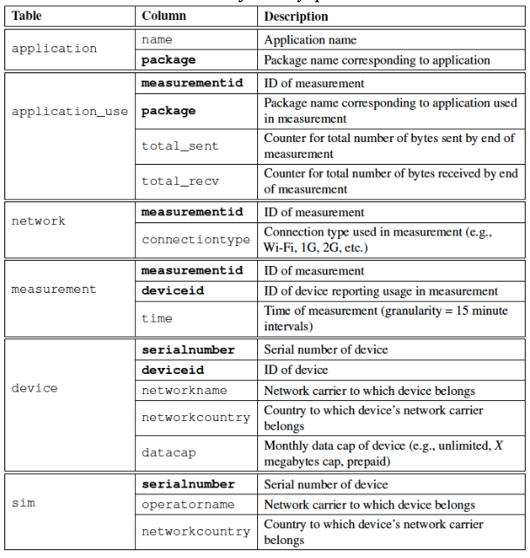

Slide 19
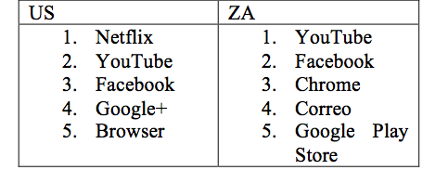
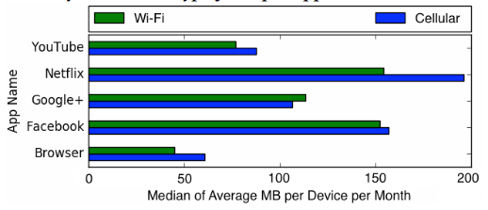
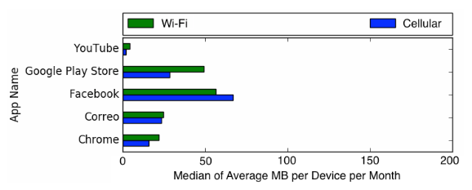
Top Five Applications
United States
South Africa

Slide 20
Summary of Findings
Users in the United States have higher mobile usage than South African users, both overall and on cellular data networks.
Mobile data usage of zero-rated applications increases during promotional periods, though the increased usage does not appear to persist indefinitely.
Current users of zero-rated services prefer full-featured applications on a paid plan over limited-service applications on a zero-rated plan.

Slide 21
Findings: Cellular vs. Wi-Fi Usage
US users consume slightly more cellular data than Wi-Fi for the top-five applications
In contrast, South African users generally prefer Wi-Fi connections (exception: Facebook)
South African users show higher usage on prepaid plans than on postpaid plans.

Slide 22
Findings: Zero-Rating
Promotions tend to increase overall usage of application on both cellular and Wi-Fi
WhatsApp on CellC
Twitter on MTN
Zero-rating services tends to be quite low, but is often used as a popular data conservation option

Slide 23
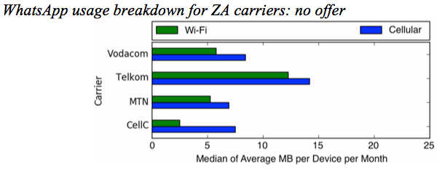
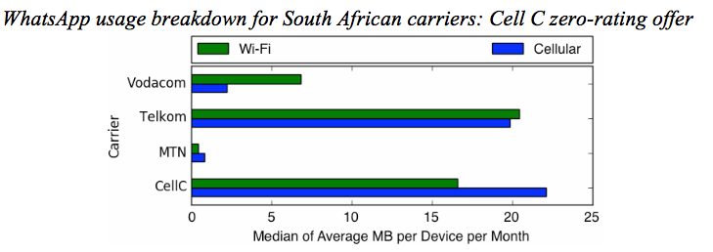
Effects of Zero Rating: CellC
Zero-rating application results in increased usage of the application on both cellular and Wi-Fi.

Slide 24
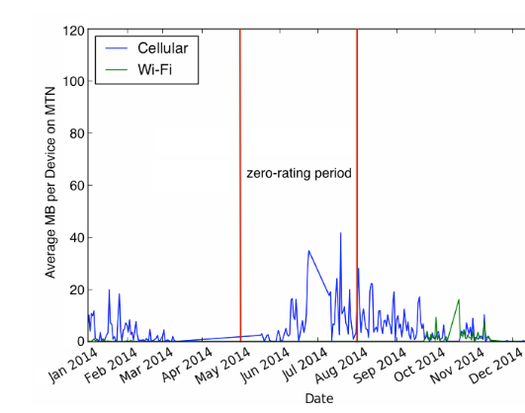
Effects of Zero-Rating: MTN
Zero-rating application increases usage during time of promotion. Some apparent “stickiness”.

Slide 25
Measurements and Approach
Longitudinal analysis of mobile usage patterns
MySpeedTest Android application
Measures application usage in 15-minute intervals, by traffic volume (in bytes)
Qualitative analysis of zero-rating effects
Mobile-based survey
User survey to give more insight into observed measurments
Notes:
Key insight: analyze longitudinal data on a diverse range of global users to explore possible pricing effects on long-term mobile data usage patterns, in addition to collecting survey responses for a more focused comparative analysis on the impact of zero-rating in developing countries. An empirical analysis on this subject actually hasn’t been studied at great length before.
Another unique aspect of this research is that it makes use of new data that has never been analyzed for this purpose. Our two sources of data come from the MySpeedTest application and a survey instrument that we created and distributed to users in South Africa and Kenya.
MySpeedTest is a mobile application created in-house that collects data on a device’s network performance (e.g. throughput and latency), user behavior (e.g. data consumed and usage frequency of different applications), and metadata (e.g. country, datacap plan, battery life). We focus on the relationships between different pieces of metadata associated with the device, and the user behavior on that device.
We also distributed a survey instrument to about 300 South African and Kenyan users that largely focuses on questions involving zero-rating practices and mobile usage breakdowns. Some questions mirror those asked in a survey distributed by A4AI as part of its ongoing study, and a handful reflect questions asked in Mathur et al.’s study. This was done to cross-validate the consistency of our survey results against those found in the corresponding papers. A4AI’s survey was fairly relevant to our study, and later we will summarize our analysis of the data collected by their original survey. Mathur et al.’s work examines overall mobile usage behaviors in South Africa while ours focuses specifically on zero-rating effects.

Slide 26
How Do Users Consume Mobile Data?
Activity | Never |  | Hardly ever |  | Sometimes |  | Most of the time |  | Always
 | SA | Kenya | SA | Kenya | SA | Kenya | SA | Kenya | SA | Kenya
Email | 3% | 1% | 8% | 2% | 23% | 29% | 26% | 22% | 39% | 46%
Social networking | 0 | 1% | 5% | 0 | 19% | 10% | 31% | 26% | 45% | 63%
Messaging | 1% | 1% | 2% | 1% | 10% | 8% | 22% | 21% | 65% | 69%
Entertainment | 6% | 3% | 7% | 7% | 43% | 41% | 19% | 29% | 25% | 21%
Education or work-related | 7% | 2% | 5% | 4% | 35% | 31% | 27% | 31% | 25% | 31%
Notes:
116/1000 respondents used zero-rating – penetration is slow
The fact that 2/3 of those who had never used the Internet prior to using a zero-rating application now used paid plans provides evidence against the walled garden argument. Instead, what we see is zero-rated apps serving as a gateway, successfully introducing users to full unlimited Internet usage
Social networking and messaging dominate usage
Majority spend < 16 USD a month on mobile data

Slide 27
How Do Users Conserve Mobile Data Use?
Activity | Never |  | Hardly ever |  | Sometimes |  | Most of the time |  | Always
 | SA | Kenya | SA | Kenya | SA | Kenya | SA | Kenya | SA | Kenya
Turn off device | 31% | 30% | 27% | 37% | 32% | 27% | 4% | 5% | 6% | 2%
Turn off mobile data | 18% | 17% | 16% | 15% | 35% | 43% | 17% | 17% | 15% | 8%
Close inactive applications | 7% | 8% | 5% | 16% | 28% | 24% | 29% | 19% | 31% | 33%
Avoid high data applications | 7% | 6% | 13% | 8% | 29% | 34% | 29% | 26% | 22% | 26%
Track data usage | 20% | 12% | 15% | 22% | 28% | 36% | 21% | 12% | 15% | 18%
Notes:
116/1000 respondents used zero-rating – penetration is slow
The fact that 2/3 of those who had never used the Internet prior to using a zero-rating application now used paid plans provides evidence against the walled garden argument. Instead, what we see is zero-rated apps serving as a gateway, successfully introducing users to full unlimited Internet usage
Social networking and messaging dominate usage
Majority spend < 16 USD a month on mobile data

Slide 28
Why Do People Use Zero-Rated Services?
Notes:
116/1000 respondents used zero-rating – penetration is slow
The fact that 2/3 of those who had never used the Internet prior to using a zero-rating application now used paid plans provides evidence against the walled garden argument. Instead, what we see is zero-rated apps serving as a gateway, successfully introducing users to full unlimited Internet usage
Social networking and messaging dominate usage
Majority spend < 16 USD a month on mobile data

Slide 29
Why Do People Venture Beyond Zero-Rated Services?
65% in Kenya and 57% in South Africa preferred to use a non-zero-rated application with full functionality.
Notes:
116/1000 respondents used zero-rating – penetration is slow
The fact that 2/3 of those who had never used the Internet prior to using a zero-rating application now used paid plans provides evidence against the walled garden argument. Instead, what we see is zero-rated apps serving as a gateway, successfully introducing users to full unlimited Internet usage
Social networking and messaging dominate usage
Majority spend < 16 USD a month on mobile data

Slide 30
Ideas for Follow-Up Studies
Use of free Wi-Fi access points around the country (vs. cellular)
Study of more promotions and zero-rated services
Correlation of usage with pricing data
Notes:
----- Meeting Notes (8/10/16 10:47) -----
Difficulty in changing carriers makes it difficult to change carriers.
Are prepaid vs. postpaid more subject to switching carriers?

Slide 31
Summary of Findings
Users in the United States have higher mobile usage than South African users, both overall and on cellular data networks.
Mobile data usage of zero-rated applications increases during promotional periods, though the increased usage does not appear to persist indefinitely.
Current users of zero-rated services prefer full-featured applications on a paid plan over limited-service applications on a zero-rated plan.

Slide 32
Policy Recommendations
South African users rely relatively more in Wi-Fi than on (more expensive) cellular data, suggesting that investments in public Wi-Fi hotspots may be effective for increasing access and usage, particularly among low-income users.
Many users of zero-rated services in South Africa and Kenya rely on zero-rated services as a data conservation mechanism, as opposed to a sole mechanism for access, suggesting that zero-rating should be encouraged as a mechanism for increasing affordable access, not necessarily viewed as a barrier.

